Slide 1
EQUILIBRIUM OF COPLANAR CONCURRENT AND NON CONCURRENT FORCE SYSTEMS

Slide 2
LECTURE 5

Slide 3
Equilibrium of a particle
Conditions for Equilibrium
Space Diagram & Free Body Diagram (FBD)
Application problems

Slide 4
EQUILIBRIUM OF FORCE SYSTEMS
Equilibrium of a particle :
If the net effect of the given forces is zero, the particle is said to be in equilibrium.
A body is said to be in equilibrium when it does not have any translatory or rotatory motion in any direction.
Equilibrium of concurrent coplanar force system :
30kN
30kN
50kN
20kN
O
20kN
50kN
Notes:
Equilibrium of a particle
Consider a particle ‘A’ acted upon by two equal and opposite forces.
If the net effect of the given force is zero and the particle is said to be in equilibrium.
For example, consider the following fig 2.1, the net force applied on the point ‘O’ to is zero.
Example for equilibrium
When the resultant of all the forces acting on a particle is zero, the particle is in equilibrium
A body is said to be in equilibrium when it does not have any translator or rotatory motion in any direction. This means that when the body is in equilibrium, the following two simultaneous conditions are to be satisfied
Equilibrium conditions
The algebraic sum of the components of the forces along each of three mutually perpendicular axes is zero. In case of coplanar forces, ΣF_{X} = 0; ΣF_{Y} = 0; ΣM= 0

Slide 5
Equilibrium conditions:
The algebraic sum of the components of the forces along each of three mutually perpendicular axes is zero.
In case of coplanar forces, ΣF_{X} = 0; ΣF_{Y} = 0

Slide 6
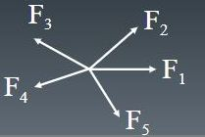
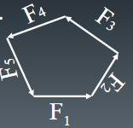
Triangle Law:
If three forces are in equilibrium, then, they form a closed triangle when represented in a Tip to Tail arrangement.
Polygonal Law:
If more than three forces are in equilibrium, then, they form a closed polygon when represented in a Tip to Tail arrangement
F₂
F₃
F₂
F₁
F₃
F₁
Notes:
Triangle Law:
If three forces are in equilibrium, then, they form a closed triangle when represented in a Tip to Tail arrangement, as shown in Figure.
Polygonal Law:
If more than three forces are in equilibrium, then, they form a closed polygon when represented in a Tip to Tail arrangement, as shown in Figure.

Slide 7
Lami’s theorem:
If a system of three “concurrent” forces is in equilibrium, then, each force of the system is proportional to sine of the angle between the other two forces (and constant of proportionality is the same for all the forces).
Note: While using Lami’s theorem, all the three forces should be either directed away or all directed towards the point of concurrence.
F3
F2
α
ᵝ
ᵞ
F1
Notes:
Lami’s theorem:
If a system of three “concurrent” forces is in equilibrium, then, each force of the system is proportional to sine of the angle between the other two forces (and constant of proportionality is the same for all the forces).
Note: While using Lami’s theorem, all the three forces should be either directed away or all directed towards the point of concurrence.

Slide 8
Equilibrium of Non-concurrent Coplanar force system
When a body is in equilibrium, it has neither translatory nor rotatory motion in any direction.
Thus the resultant force R and the resultant couple M are both zero, and we have the equilibrium equations for two dimensional force system as
These requirements are both necessary and sufficient conditions for equilibrium.
∑ F_{x} = 0; ∑ F_{y} = 0 & ∑M = 0
Notes:
When a body is in equilibrium, it has neither translatory nor rotatory motion in any direction.
Thus the resultant force R and the resultant couple M are both zero, and we have the equilibrium equations for two dimensional force system:
∑ F_{x} = 0; ∑ F_{y} = 0 & ∑M = 0
These requirements are both necessary and sufficient conditions for equilibrium.

Slide 9
Space and Free body diagrams
Space diagram :
The sketch showing the physical conditions of the problem, like, the nature of supports provided; size, shape and location of various bodies; forces applied on bodies, etc.,
Cable
2 kN
2 m
ө
45˚
Sphere
1 kN
Wall
30˚
Wt. of the sphere = 1 kN
Radius of the sphere = 0.5 m
2 kN
Floor
Figure 1
Figure 2
Notes:
Space diagram and free body diagram
The problems in Engineering Mechanics always involve the interaction of bodies upon one another, and are derived from an actual physical situation.
Space Diagram (SPD) : The sketch showing the physical conditions of the problem, like, the nature of supports provided; size, shape and location of various bodies; forces applied on the bodies, etc., is known as space diagram.
OR
A sketch showing the physical conditions of the problem is known as space diagram.

Slide 10
1 kN
30˚
2 kN
Floor
Figure 1

Slide 11
2 kN
2 m
ө
T
45˚
R_{W}
Sphere
1 kN

Slide 12
Free body diagram :
An isolated view of a body which shows only the external forces acting on the body
2 kN
2 m
2 kN
ө
T
1 kN
45˚
30˚
R_{W}
Sphere
R_{F}
1 kN
Figure 1
Figure 2
Notes:
Free Body Diagram (FBD) :
It is an isolated diagram of the body being analyzed (called free body), in which, the body is shown freed from all its supports and contacting bodies/surfaces. Instead of the supports and contacting bodies/surfaces, the reactive forces exerted by them on the free body is shown, along with all other applied forces.
OR
An isolated view of a body which shows only the external forces acting on the body is called Free Body Diagram. [FBD]
A free body diagram may be drawn for any single member of a system, any subsystem of the system or the entire system irrespective of whether the system is in equilibrium, at rest, in uniform motion or in a dynamic state of motion.
It is most a very important single step in the solution of problems in mechanics. The external forces are caused either by direct contact, or by gravitational or magnetic attraction. In addition to these forces, the principle of transmissibility when introduced, permits the treatment of force as a sliding vector as far as its external effects on a rigid body are concerned. We know that forces always occur in pairs [Newton’s IIIrd Law], but, a free-body diagram shows only the forces acting upon the isolated body. It does not show the forces exerted by the free body upon other bodies or those within the body.
The following steps are involved in the construction of free-body diagrams
Step 1: Imagine and make clear decision about which body or combination of bodies is to be isolated from all other bodies and surroundings. The body chosen will usually involve one or more of the desired unknown quantities (forces).
Step 2: The body or combination of bodies chosen is next isolated from the space diagram. This step is the most crucial of all, because the body is completely isolated from all other contacting or attracting bodies. Draw the big, legible, clear and neat F.B.D. so that all the required data can be clearly shown on the FBD.
Step 3: Represent the action of each body or support, that has been removed by a force or its components
Step 4: a] If there are only two concurrent forces, then resultant can be obtained by i)law of parallelogram ii)Law of triangle of forces
b] If three concurrent forces are (in equilibrium) acting on a particle, then resultant can be obtained by i) Law of triangle ii) Lami’s Theorem
c] If there are three or more forces acting, then resolve the forces along two mutually perpendicular directions and find the resultant.
d] Resolution of forces is preferred over Lami’s theorem to find the unknown forces (resultant) since Lami’s theorem does not give the direction of the forces
Advantages of drawing clear, accurate free body diagram
To reduce real systems to accurate, idealized models that may be analysed mathematically
To see and understand separate parts of a problem
To identify known and unknown quantities in a problem
To efficiently outline one’s approach to the solution of a problem
To make accurate, simplifying approximations
To progress step by step through a solution

Slide 13
Few Guidelines for Drawing FBD:
Tensile Force – vector directed away from the body
Compressive Force - vector directed towards the body
Reactions at smooth surfaces - normal to the surface and pointing towards the body
Forces in Link rods/connecting rods – along the axis (towards or away from the body)
Forces in Cables (Strings or Chords) - along the cable and directed away from the body (tension)
Notes:
A Few Guidelines for Drawing FBD:
Tensile Force: It is a force trying to pull or extend the body. It is represented by a vector directed away from the body.
Compressive Force: It is force trying to push or contract the body. It is represented by a vector directed towards the body.
Reactions at smooth surfaces: The reactions of smooth surfaces, like walls, floors, Inclined planes, etc. will be normal to the surface and pointing towards the body.
Forces in Link rods/connecting rods: These forces will be acting along the axis of the rod, either towards or away from the body. (They are either compressive or tensile in nature).
Forces in Cables (Strings or Chords): These can only be tensile forces. Thus, these forces will be along the cable and directed away from the body.

Slide 14
Application Problems
Determine the magnitude and nature of the forces in the bars AB and AC shown in figure. Neglect size and weight of the pulley.
B
30
D
A
60
C
40 kN

Slide 15
Application Problems
Determine the magnitude and nature of the forces in the bars AB and AC shown in figure. Neglect size and weight of the pulley.
B
30
D
A
60
C
40 kN

Slide 16
Application Problems
Determine the magnitude and nature of the forces in the bars AB and AC shown in figure. Neglect size and weight of the pulley.
Y
(+ve)
B
30
F_{AB}
X
D
A
(+ve)
60
30
C
T =40 kN
60
40 kN
30
60
F_{AC}
X
W=40 kN
Y

Slide 17
Angle between F_{AB} and F_{AC} = 90^{0.}Taking F_{AC} as
X-axis and F_{AB} as Y– axis
Y
(+ve)
F_{AB}
X
∑FX=0
+ve
(+ve)
30
-FAC- 40 Cos 0- 40 Cos 60 = 0
60
T =40 kN
FAC = - 54.64kN = 54.64 (C)
30
∑FY=0
+ve
60
F_{AC}
X
FAB + 40 Sin30 – 40 Sin 60 = 0
Y
W=40 kN
FAB = 14.64 kN ( T )
Fig (2a) F B D at A

Slide 18
(2) A wire is fixed at two points A and D as shown in Fig. Determine inclination of the segment BC to the vertical and the tension in all the segments.
A
30
D
B
60
C
θ
20kN
25 kN

Slide 19
+ve
∑FX=0
T_{BC}Sine θ –T_{BA}Sine 30=0 -----(1)
∑FY=0
-T_{BC} Cos θ+T_{BA}Cos 30-20=0 ----(2)
TBA
FBD at ‘B’
+ve
30
+ve
∑FX=0
T_{CD}Sine60-T_{CB}Sineθ =0----(3)
∑FY=0
T_{CB}Cosθ +T_{CD}Cos60-25=0---(4)
TBC
20 kN
θ
+ve
TCB
TCD
θ
Add (1) & (3)
T_{CD} Sine60-T_{BA} Sine30=0---(5)
Add (2) & (4)
T_{CD} cos60+T_{BA} cos30=45---(6)
60
FBD at ‘C’
25kN

Slide 20
Solving(5) & (6) we get
T_{BA}=38.98kN,T_{CD}=22.51kN
Substituting in (1) &(4) we get
T_{BC}sineθ=19.49---(A)
T_{BC}cosθ=13.75---(B)
Dividing(A) & (B)
Tanθ=1.417
θ=54.79⁰
Substituting in (A) we get T_{BC}= 23.86kN

Slide 21
LECTURE 6

Slide 22
Types of Beam supports & Support reactions
Types of Beams
Types on Loads on beam

Slide 23
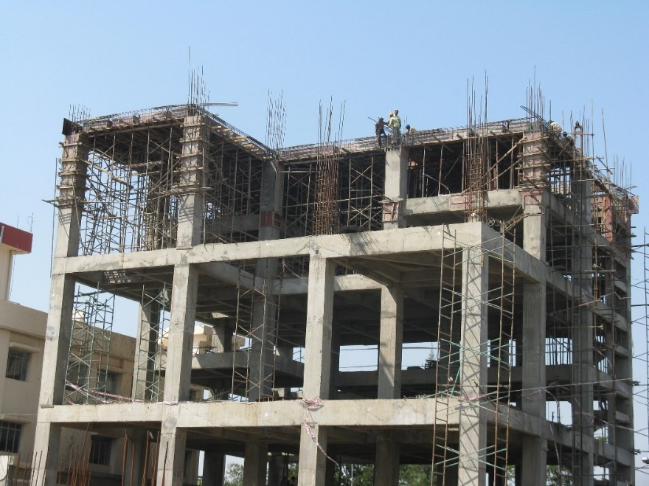
Types of Beam Supports & Support Reactions
Beam: A beam is a structural element which is capable of withstanding load primarily by resisting bending.
Supports: A structure is subjected to external forces and transfers these forces through the supports on to the foundation. Therefore the support reactions and the external forces together keep the structure in equilibrium.
Roller Support
Hinged or pinned support
Fixed or built in support
Notes:
Supports:
A structure is subjected to external forces and transfers these forces through the supports on to the foundation. Therefore the support reactions and the external forces together keep the structure in equilibrium.

Slide 27
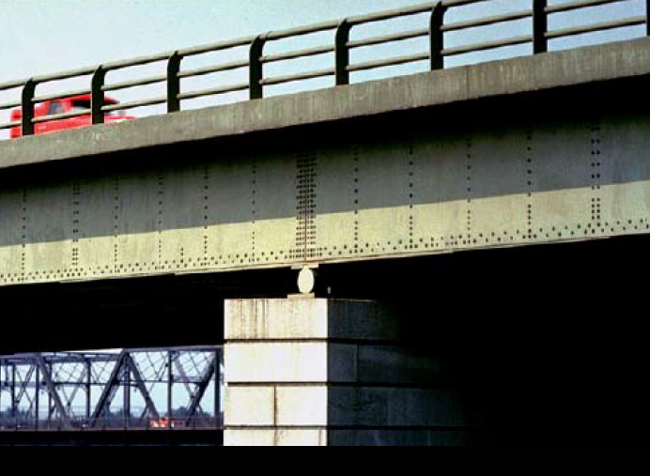
Roller Support
A
A
Notes:
Roller Support:
Contact force is normal to the surface on which the roller is free to move. The reaction will always be perpendicular to the plane of the roller . Roller support will offer only one independent reaction component. (Whose direction is known.)

Slide 28
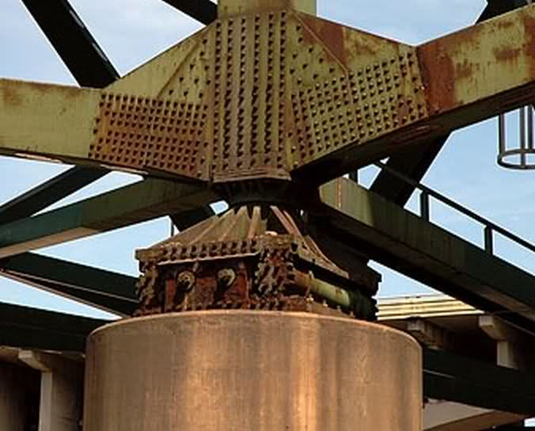
Hinged or pinned support
A
R_{h}
A
θ
R_{v}
R
Notes:
Hinged or pinned support:
This support does not allow any translatory movement of the rigid body. There will be two independent reaction components at the support. The resultant reaction can be resolved into two mutually perpendicular components. Or it can be shown as resultant reaction inclined at an angle with respect to a reference direction.

Slide 29
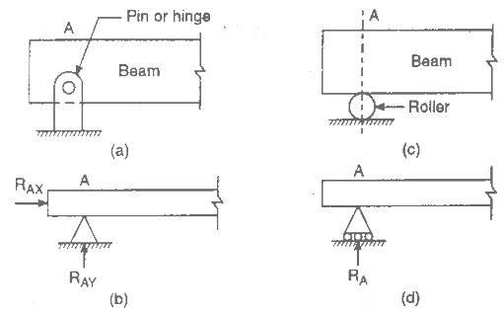

Slide 30
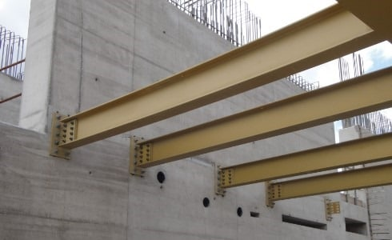
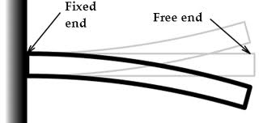
Fixed or Built-in Support
A
A
R_{AH}
M
R_{AV}
Notes:
Fixed or built in support:
This type of support not only prevents the translatory movement of the rigid body, but also the rotation of the rigid body. Hence there will be 3 independent reaction components of forces Hence there will be 3 unknown components of forces, two mutually perpendicular reactive force component and a reactive moment as shown in the figure.

Slide 31
Types of Beams
Simply supported beam
Cantilever beam
Overhanging beam
Notes:
A beam is a structural element that is capable of withstanding load primarily by resisting bending

Slide 35
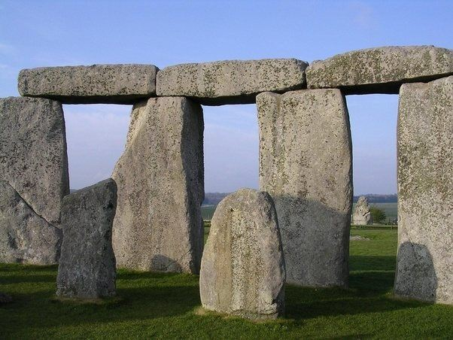
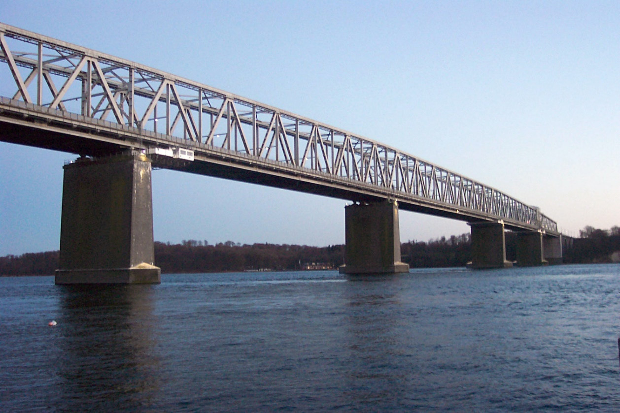
Simply Supported Beam
A
B
span
A
B
span
Notes:
Simply supported beam:
A beam generally supported by a hinge or roller at the ends having one span (distance between the support) is called as simply supported beam.

Slide 36
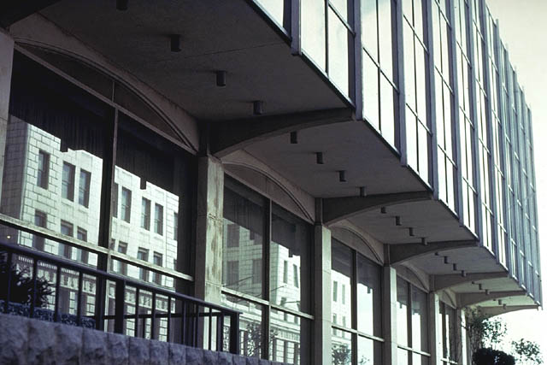
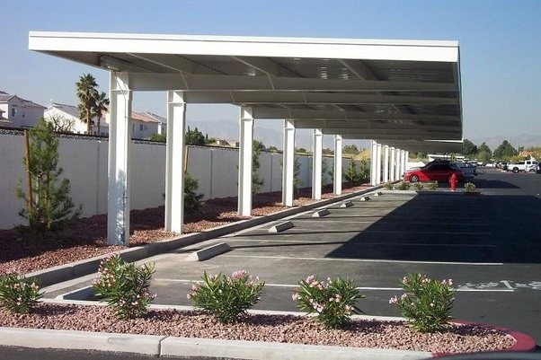
Cantilever Beam
A
B
span
M
R_{H}
A
B
R_{v}
Notes:
Cantilever beam:
A beam which is fixed at one end and free at another end is called as a cantilever beam.

Slide 37

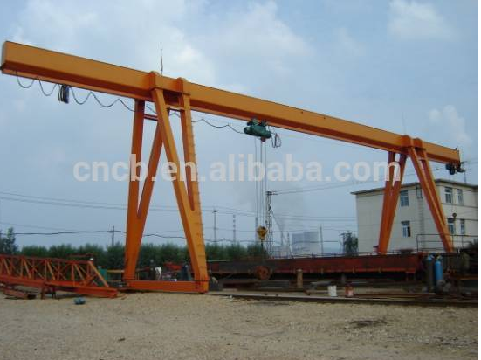
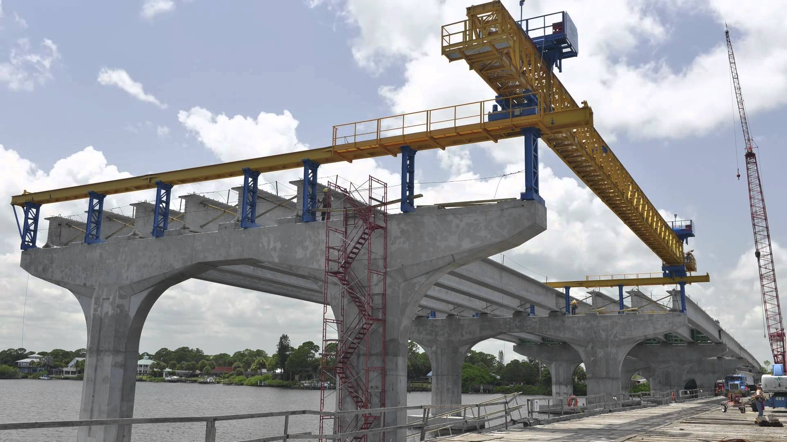
Overhanging Beam
A
B
A
B
Notes:
Overhanging beam:
If one end or both ends of the beam project beyond the support it is known as overhanging beam.

Slide 38
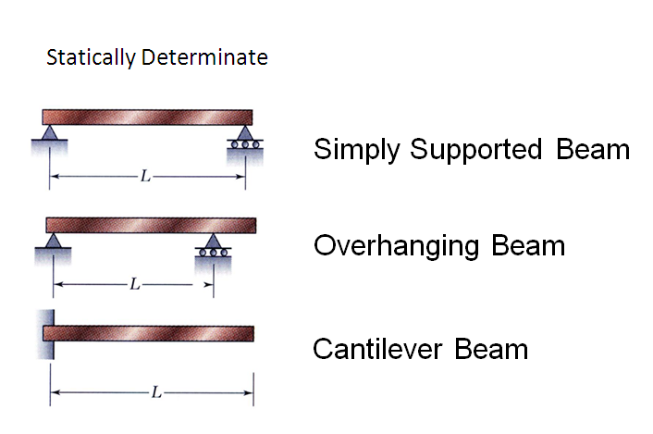
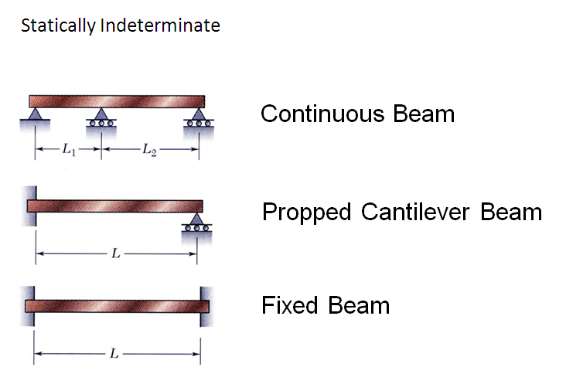
Statically Determinate & Indeterminate Beams
Notes:
Statically determinate beam
A beam is said to be statically determinate beam if the number of unknown reactions are less or same as that of equilibrium conditions.
OR
Using the equations of equilibrium, if all the reaction components can be found out, then the beam is a statically determinate beam.
OR
The beams in which number of unknowns are less than or equal to three are called statically determinate beams.
The equations of equilibrium:
∑ Fx = 0; ∑ Fy = 0 ∑M = 0

Slide 39
Loads on Beam
Concentrated or Point load
Uniformly distributed load (UDL)
Uniformly varying load (UVL)

Slide 43
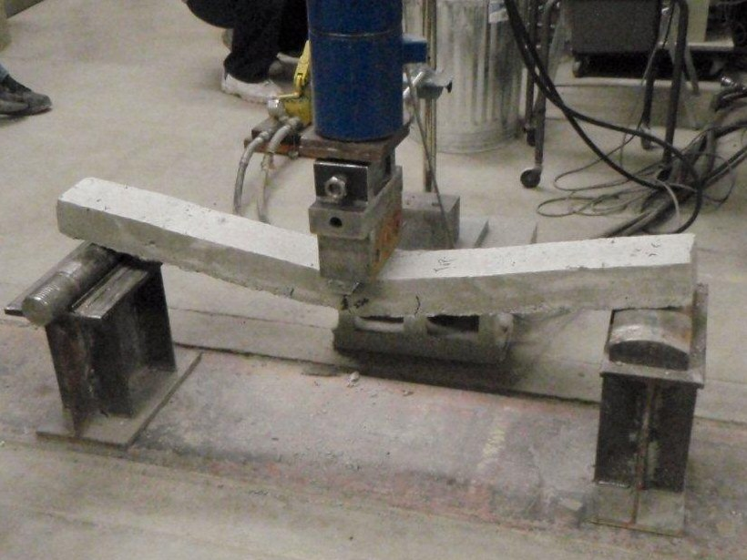
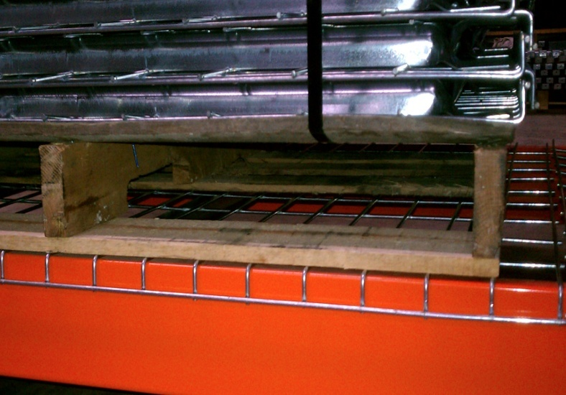
Concentrated or Point Load
W kN
A
B
L
Uniformly Distributed Load (UDL)
W = (w x L) kN
w kN/m
L/2
A
B
A
B
L
L
Notes:
Types of loads on beams:
Concentrated load or point load: This is the load acting for very small length of the beam. (also known as point load, Total load W is acting at one point )
Uniformly distributed load : This is the load acting for a considerable length of the beam with same intensity of w kN/m throughout its spread.
Total intensity, W = w × L
(acts at L/2 from one end of the spread)

Slide 44
Uniformly Varying Load (UVL)
Triangular Load
Trapezoidal Load
w1 kN/m
w2 kN/m
w kN/m
L
L
W₂ = w₁× L
W₁ = ½ × (w₂-w₁) × L
W = ½ × L × w
1/3 × L
1/3 ×L
2/3 × L
2/3 ×L
w₂
w₁
L/2
L/2
L
L
Notes:
Uniformly varying load: This load acts for a considerable length of the beam with intensity varying linearly from ‘0’ at one end to w kN/m to the other representing a triangular distribution.
Total intensity of load = area of triangular spread of the load
W = 1/2× w × L.
(acts at 2×L/3 from ‘Zero’ load end)

Slide 45
LECTURE 7

Slide 46
Application Problems Continued…

Slide 47
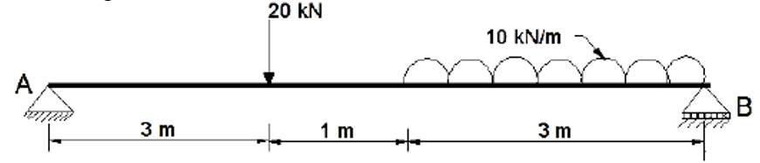
Find the support reactions for the beam loaded shown in figure.
20kN
30kN
R_{AH}
A
B
RAV
3m
1m
1.5m
1.5m
RB

Slide 48
20kN
30kN
R_{AH}
A
B
RAV
3m
1m
1.5m
1.5m
RB

Slide 49
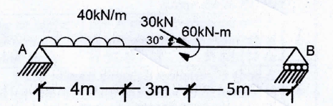
Determine the support reactions for the beam shown in the Figure.
30 Sine30
160 kN
R_{AH}
A
2m
30 Cos30
60 kN-m
B
R_{AV}
4m
3m
5m
R_{B}

Slide 50
30 Sine30
160 kN
R_{AH}
A
2m
30 Cos30
60 kN-m
B
R_{AV}
4m
3m
5m
R_{B}

Slide 52
Find the support reactions for the beam loaded shown in figure.
20kN
30kN
R_{AH}
A
B
RAV
3m
1m
1.5m
1.5m
RB

Slide 53
20kN
30kN
R_{AH} = 0
A
B
R_{AV} = R_{A}
3m
1m
1.5m
1.5m
R_{B}
M_{A} = 0
R_{B} × 7- 30 ×5.5 - 20 × 3 =0
R_{B} = 32.14kN
+ve
F_{V} = 0
R_{A}– 20 – 30 + 32.14 = 0
R_{A} = 17.86 kN

Slide 54
Determine the support reactions for the beam shown in the Figure.
30 Sine30
160 kN
R_{AH}
A
2m
30 Cos30
60 kN-m
B
R_{AV}
4m
3m
5m
R_{B}

Slide 55
30 Sine30
160 kN
R_{AH}
A
2m
30 Cos30
60 kN-m
B
R_{AV}
4m
3m
5m
R_{B}
M_{A} = 0
R_{B} ×12- 30 sin30×7- 60 - 160 × 2= 0
R_{B} = 40.42 kN
R_{A}
R_{AV}
+ve
ϴ_{X}
F_{H}= 0
-R_{AH} + 30cos30 = 0
R_{AH} = 25.98 kN
F_{V} = 0
R_{AV} – 30 sin30 – 160 + 40.42 = 0
R_{AV} = 134.58 kN
R_{AH}
+ve

Slide 56
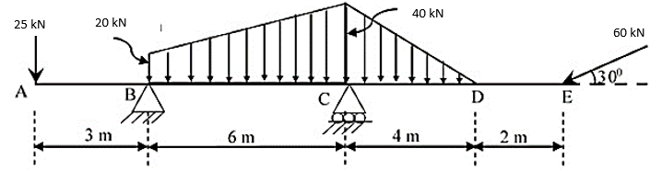
5. Determine the support reactions at B and C.
25kN
120kN
80kN
60kN
60kN
60 Sine30
R_{BH}
30⁰
A
B
C
D
E
60 Cos 30
3m
3m
3m
1.33m
2.67m
2m
R_{BV}
4m
R_{C}

Slide 57
25kN
120kN
80kN
60kN
60kN
60 Sine30
R_{BH}
30⁰
A
B
C
D
E
60 Cos 30
3m
3m
3m
1.33m
2.67m
2m
R_{BV}
R_{C}
4m
M_{B}= 0
R_{C} ×6- 60 sin30×12- 80 × 7.33 -60 × 4- 120 × 3 + 25 × 3 = 0
R_{C} = 245.23 kN
+ve
F_{H}= 0
R_{BH} - 60cos30 = 0
R_{BH} = 51.96 kN
F_{V} = 0
R_{BV} – 60 sin30 – 80-60 – 120 +245.23 - 25= 0
R_{BV} = 69.77 kN
+ve
R_{BV}
R_{B}
R_{B} = 86.99kN
θ_{X} = 53.32⁰
θ_{X}
R_{BH}

Slide 58
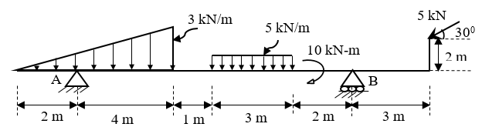
Determine the reactions that develop at the supports A and B for the beam loaded as shown in the figure.
5 sine 30
5kN
30⁰
5 Cos 30
15kN
9kN
2m
10kN-m
R_{AH}
A
B
2m
2m
4m
1m
1.5m
1.5m
2m
R_{B}
3m
R_{AV}

Slide 59
5 sine 30
5kN
30⁰
5 Cos 30
15kN
9kN
2m
10kN-m
R_{AH}
A
B
2m
2m
4m
1m
1.5m
1.5m
2m
R_{B}
3m
R_{AV}
+ve
M_{A} = 0
R_{B} ×10- 5 sin30×13 +5 Cos 30 × 2-10-15×6.5 – 9 × 2= 0
R_{B} = 14.93 kN
F_{H}= 0
R_{AH} - 5cos30 = 0
R_{AH} = 4.33 kN
F_{V} = 0
R_{AV} + 14.93 – 5 sin30 – 15- 9 = 0
R_{AV} = 11.57 kN
+ve
R_{AV}
R_{A}
R_{A} = 12.35 kN
θ_{X} = 69.48⁰
θ_{X}
R_{AH}

Slide 60
Determine the reactions at A, C and D due to the forces acting on the beam.
40 kN
20 kN
10 kN
B
45˚
A
0.5m
C
60˚
D
0.5m
1m
1m
10 kN
20 kN
1m
1m
1m

Slide 61
Determine the reactions at A, C and D due to the forces acting on the beam.
40 kN
20 kN
10 kN
B
45˚
A
0.5m
C
60˚
D
0.5m
20 kN
1m
1m
10 kN
1m
1m
1m
F.B.D of the upper Beam
20 kN
40 kN
45˚
R_{AH}
B
A
3m
R_{B}
1m
R_{AV}
10 kN-m
C
A
R_{CH}
60˚
D
R_{D}
R_{CV}
20 kN
1m
1m
1m
1m

Slide 62
F.B.D of the upper Beam
20 kN
40 kN
45˚
R_{AH}
B
F_{H}= 0
R_{AH}+40cos45= 0
R_{AH} = -28.28kN
F_{V} = 0
R_{AV} -40sin45 – 20+57.71kN = 0
R_{AV} =- 9.43kN, R_{AV} = 9.43kN
A
R_{AV}
3m
R_{B}
1m
R_{AH} = 28.28kN
M_{A} = 0
R_{B} ×3- 40 sin45×4 -20 ×3 =0
R_{B} = 57.71kN
F.B.D of the lower Beam
57.71kN
10 kN-m
F_{H}= 0
R_{AH}-20cos60= 0
R_{AH} = 10kN
F_{V} = 0
R_{CV} -20sin60 – 57.71kN+40.91 = 0
R_{CV} =34.12kN
R_{CH}
C
A
60˚
D
3m
R_{D}
R_{CV}
20 kN
1m
1m
1m
1m
M_{C} = 0
R_{D} ×3- 20 sin60×1 -57.71 ×2+10 = 0
R_{D} = 40.91kN

Slide 63
Determine the reactions in the cantilever beam shown.
40kN
0.5m
30⁰
20 kN/m
40 Cos 30
0.7m
B
A
3m
1m
1m
40 Sin 30
40kN
0.5m
60 kN
30⁰
40 Cos 30
0.7m
B
R_{BH}
A
M_{B}
3m
1.5m
1m
1m
R_{BV}

Slide 64
Determine the reactions in the cantilever beam shown.
40 Sin 30
40kN
0.5m
60 kN
30⁰
40 Cos 30
0.7m
B
R_{BH}
A
M_{B}
R_{BV}
F_{V} = 0
R_{BV} – 60-40Sin30=0
R_{BV}= 80kN
3m
1.5m
1m
1m
+
M_{B}= 0
40sin30 ×0.5 + 40cos30 ×0.7 +60×3.5-M=0
M=244.25kN-m
+
F_{H} = 0
-R_{BH} –40Cos30=0
R_{BV}= -34.64kN
R_{BH}= 34.64kN

Slide 65
TUTORIAL (Additional)

Slide 66
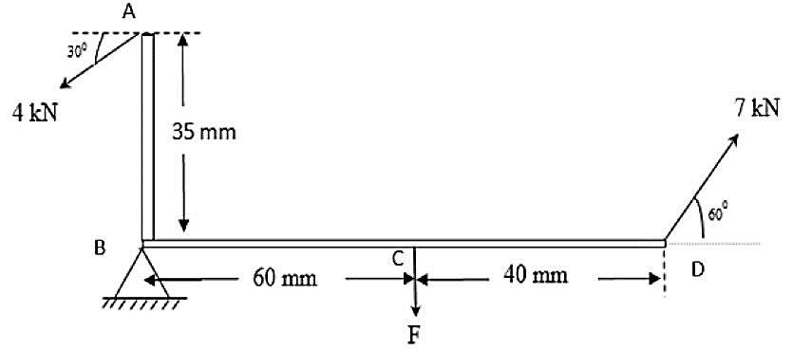
A beam ABCD, hinge supported at B is subjected to loads as shown in the figure. Calculate force 'F' and reactions at support B. (2 marks)

Slide 67
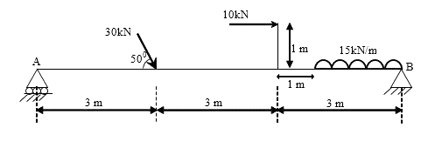
Determine the reactions at the supports A and B for the beam loaded as shown in the figure. (4 marks)

Slide 68
LECTURE 8

Slide 69
FRICTION

Slide 70
Introduction
Terms and Definitions
Static, Limiting and Kinetic Friction
Laws of dry friction
Application Problems

Slide 71
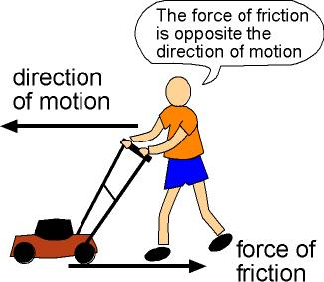
Introduction
Force which opposes the movement or tendency of movement is known as frictional resistance or friction.
Defined broadly as the resistance that occurs between two bodies in contact when they tend to slide or roll relative to one another.
A frictional force is a shear force that acts tangent to the surface of contact between two bodies. This force opposes sliding motion between the bodies.
Notes:
Friction :
Friction is defined as the contact resistance exerted by one body upon another body when one body moves or tends to move past another body.
This force which opposes the movement or tendency of movement is known as frictional resistance or friction.
Friction is due to the resistance offered by minute projections at the contact surfaces. Hence friction is the retarding force, always opposite to the direction of motion.
OR
Friction is a force that opposes relative motion between systems in contact.
Friction may be defined broadly as the resistance that occurs between two bodies in contact when they tend to slide or roll relative to one another. Below discussed are the three approximate rules of friction that were established by Charles A. Coulomb (1736-1806), but are still useful today.
Frictional resistance is due in large part to the roughness of various materials, such as metals, concrete, wood, plastic, and composites. It is seen that surface roughness determines, in part, the amount of friction that exists between bodies. One can analyze the performance of several mechanical devices in which friction plays a central role. These devices include the wedge, screw and jackscrew, as well as belt-pulley assemblies, clutches and brakes.
Friction can be simultaneously beneficial and harmful. For example, friction enables to walk, but it also causes the soles of shoes to wear out. Friction can be used to produce desirable wear. For example, it may be used to grind and polish metals and to “break in” a new car engine.
In the career as an engineer, one should deal with the two faces of friction. In some situations, friction is a help; in other situations, it is a hindrance. It is necessary to adapt and/or improvise to utilize its unique characteristics.
Advantages & disadvantages of friction is summarized as follows:.
Disadvantages → Power loss, wear and tear etc.
Advantages → Brakes, traction for vehicles etc.
A frictional force is a shear force that acts tangent to the surface of contact between two bodies. This force opposes sliding motion between the bodies.
Friction Facts and Coefficients of Friction:
What causes friction between two bodies that tend to move relative to one another while in contact?. Metallurgists have found that at least three things do.
One cause of friction is the intermeshing of microscopic, teeth like irregularities that are present on any surface. This microscopic roughness exists even on polished surfaces.
A second cause of friction is adhesion between surfaces, probably due to molecular attraction. Interestingly, this factor increases in importance for highly polished surfaces. For example, this effect occurs with flat-ground gauge blocks used in machine shops. These blocks cling together if pressed and twisted against one another. Two flat pieces of glass, if wrung together to exclude air, will also stick together.
A third cause of friction is an indentation on one body caused by a second, harder body. To move relative to the first body, the harder body must climb out of the hole it has created. This effect is a factor in rolling resistance, as well as in sliding friction. Other factors, such as electrostatic attraction and elastic stretching between bodies may also cause friction.
Lubricants, such as oil, wax, and graphite, reduce friction by providing a film that separates the bodies in contact. For example, oil tends to fill in gaps or irregularities on surfaces so that the bodies slide on a thin layer of oil instead of over interlocking protuberances.
The force of static friction is maximum when the two bodies in contact are just ready to slip relative to each other.
The maximum value of the frictional force between two contacting bodies in static equilibrium is reached when sliding between the two bodies is about to occur. At this instant, sliding is impending. This maximum frictional force is determined experimentally, since it depends on the nature of the contacting surfaces. For example, the maximum value of the frictional force is reduced considerably if the surfaces are lubricated. Osborne Reynolds, a pioneer in the study of fluid mechanics, attributed the slipperiness of ice to a lubricating film of water. He concluded that very cold ice would not be slippery, a conclusion that was verified by Arctic explorers. The study of , lubrication of surfaces requires an understanding of principles of fluid mechanics. Hence, it is usually taught in senior-level university courses in mechanical engineering, material sciences, or metallurgy. We restrict our study mainly to dry friction, between unlubricated surfaces.
The maximum force of friction increases as the normal force between the bodies increases.
The frictional force that exists when two contacting bodies are about to slide relative to one another is generally larger than the frictional force when they are sliding.

Slide 72
Plays very important role in the analysis of the performance of various mechanical devices.
Friction – Beneficial and harmful
Advantages:
Walk, Traction, Brake, grind and polish
Disadvantages:
Power loss, wear and tear
Notes:
Friction :
Friction is defined as the contact resistance exerted by one body upon another body when one body moves or tends to move past another body.
This force which opposes the movement or tendency of movement is known as frictional resistance or friction.
Friction is due to the resistance offered by minute projections at the contact surfaces. Hence friction is the retarding force, always opposite to the direction of motion.
OR
Friction is a force that opposes relative motion between systems in contact.
Friction may be defined broadly as the resistance that occurs between two bodies in contact when they tend to slide or roll relative to one another. Below discussed are the three approximate rules of friction that were established by Charles A. Coulomb (1736-1806), but are still useful today.
Frictional resistance is due in large part to the roughness of various materials, such as metals, concrete, wood, plastic, and composites. It is seen that surface roughness determines, in part, the amount of friction that exists between bodies. One can analyze the performance of several mechanical devices in which friction plays a central role. These devices include the wedge, screw and jackscrew, as well as belt-pulley assemblies, clutches and brakes.
Friction can be simultaneously beneficial and harmful. For example, friction enables to walk, but it also causes the soles of shoes to wear out. Friction can be used to produce desirable wear. For example, it may be used to grind and polish metals and to “break in” a new car engine.
In the career as an engineer, one should deal with the two faces of friction. In some situations, friction is a help; in other situations, it is a hindrance. It is necessary to adapt and/or improvise to utilize its unique characteristics.
Advantages & disadvantages of friction is summarized as follows:.
Disadvantages → Power loss, wear and tear etc.
Advantages → Brakes, traction for vehicles etc.
A frictional force is a shear force that acts tangent to the surface of contact between two bodies. This force opposes sliding motion between the bodies.
Friction Facts and Coefficients of Friction:
What causes friction between two bodies that tend to move relative to one another while in contact?. Metallurgists have found that at least three things do.
One cause of friction is the intermeshing of microscopic, teeth like irregularities that are present on any surface. This microscopic roughness exists even on polished surfaces.
A second cause of friction is adhesion between surfaces, probably due to molecular attraction. Interestingly, this factor increases in importance for highly polished surfaces. For example, this effect occurs with flat-ground gauge blocks used in machine shops. These blocks cling together if pressed and twisted against one another. Two flat pieces of glass, if wrung together to exclude air, will also stick together.
A third cause of friction is an indentation on one body caused by a second, harder body. To move relative to the first body, the harder body must climb out of the hole it has created. This effect is a factor in rolling resistance, as well as in sliding friction. Other factors, such as electrostatic attraction and elastic stretching between bodies may also cause friction.
Lubricants, such as oil, wax, and graphite, reduce friction by providing a film that separates the bodies in contact. For example, oil tends to fill in gaps or irregularities on surfaces so that the bodies slide on a thin layer of oil instead of over interlocking protuberances.
The force of static friction is maximum when the two bodies in contact are just ready to slip relative to each other.
The maximum value of the frictional force between two contacting bodies in static equilibrium is reached when sliding between the two bodies is about to occur. At this instant, sliding is impending. This maximum frictional force is determined experimentally, since it depends on the nature of the contacting surfaces. For example, the maximum value of the frictional force is reduced considerably if the surfaces are lubricated. Osborne Reynolds, a pioneer in the study of fluid mechanics, attributed the slipperiness of ice to a lubricating film of water. He concluded that very cold ice would not be slippery, a conclusion that was verified by Arctic explorers. The study of , lubrication of surfaces requires an understanding of principles of fluid mechanics. Hence, it is usually taught in senior-level university courses in mechanical engineering, material sciences, or metallurgy. We restrict our study mainly to dry friction, between unlubricated surfaces.
The maximum force of friction increases as the normal force between the bodies increases.
The frictional force that exists when two contacting bodies are about to slide relative to one another is generally larger than the frictional force when they are sliding.

Slide 73
Terms and Definitions
Coefficient of friction (μ)
Total reaction (R)
Angle of Friction (Ɵ)
Angle of limiting friction (φ)
Angle of repose (α)
W
P
F
Ɵ
Angle of friction
Normal Reaction (N)
Total Reaction (R)

Slide 74

Coefficient of friction (μ) = F_{max} / N
Total reaction : Frictional force and the normal reaction could be replaced by a single force called Total reaction. R =
Angle of Friction (Ɵ)
Angle of Limiting Friction (φ) : An angle made by the total reaction (R) with the normal reaction (N) when F has reached F_{max}. tanφ = F_{max} / N
Angle of Repose (α) : The limiting angle up to which the grains repose (sleep/rest) is called the angle of repose of the granular material
Notes:
1) Coefficient of friction (μ) : When F has reached Fmax, it bears a constant ratio with the normal reaction. This constant is called Coefficient of friction .
μ = F_{max} / R_{N}
2) Total reaction ( R ): Frictional force and the normal reaction could be replaced by a single force called Total reaction.
R=√F² + R_{N}²
3) Angle of Friction (φ ): It is the angle made by the total reaction with the normal reaction when F has reached F_{max}.
tanφ=F_{max} / R_{N}
4) Angle of repose
When granular material is heaped, there exists a limit for the inclination of the surface. Beyond that angle, the grains start rolling down. This limiting angle upto which the grains repose (sleep) is called the angle of repose of the granular material.

Slide 75

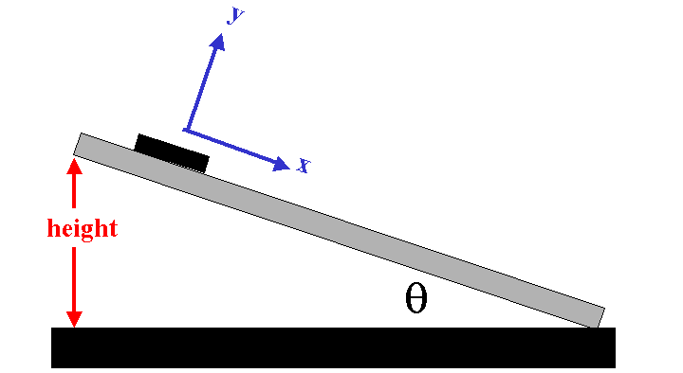

Limiting Friction: The maximum frictional force that can arise before an object begins to slide.
Static friction: Body remains at rest when the applied force is less than the limiting friction.
Dynamic friction OR Kinetic friction: Frictional resistance experienced by the body while in motion.
Notes:
Frictional resistance has the remarkable property of adjusting itself in magnitude of force producing or tending to produce the motion so that the motion is prevented.
When P = 0, F = 0 → block under equilibrium
When P increases, F also increases proportionally to maintain equilibrium. However there is a limit beyond which the magnitude of this friction cannot increase.
Limiting Friction:
When the block is on the verge of motion(motion of the block is impending) F attains maximum possible value, which is termed as Limiting Friction.
Static friction:
When the applied force is less than the limiting friction, the body remains at rest and such frictional resistance is called the static friction.
Dynamic friction OR Kinetic friction:
Further if P is increased, the value of F decreases rapidly and then remains fairly a constant thereafter. However at high speeds it tends to decrease. This frictional resistance experienced by the body while in motion is known as dynamic friction OR kinetic friction.

Slide 76
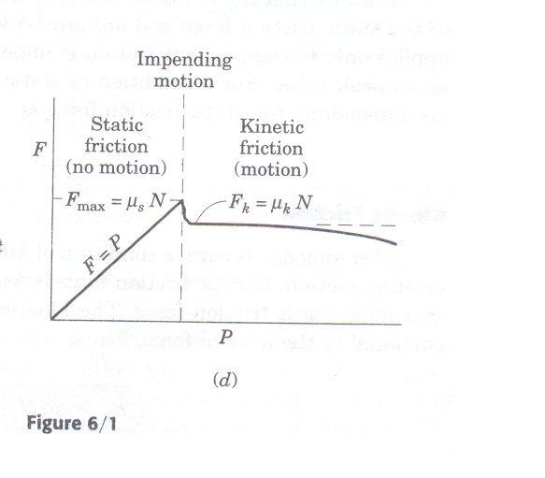
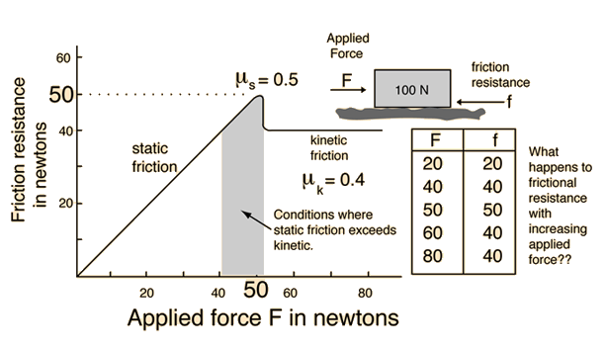
Notes:
Frictional resistance has the remarkable property of adjusting itself in magnitude of force producing or tending to produce the motion so that the motion is prevented.
When P = 0, F = 0 → block under equilibrium
When P increases, F also increases proportionally to maintain equilibrium. However there is a limit beyond which the magnitude of this friction cannot increase.
Limiting Friction:
When the block is on the verge of motion(motion of the block is impending) F attains maximum possible value, which is termed as Limiting Friction.
Static friction:
When the applied force is less than the limiting friction, the body remains at rest and such frictional resistance is called the static friction.
Dynamic friction OR Kinetic friction:
Further if P is increased, the value of F decreases rapidly and then remains fairly a constant thereafter. However at high speeds it tends to decrease. This frictional resistance experienced by the body while in motion is known as dynamic friction OR kinetic friction.

Slide 77
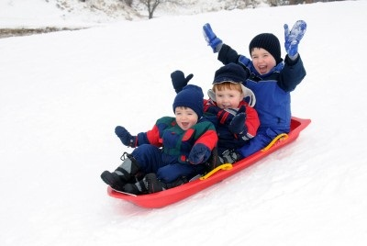
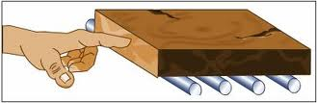
Sliding friction→ friction experienced when a body slides over another surface.
Kinetic/Dynamic Friction
Rolling friction → friction experienced by a body when it rolls over a surface.

Slide 78
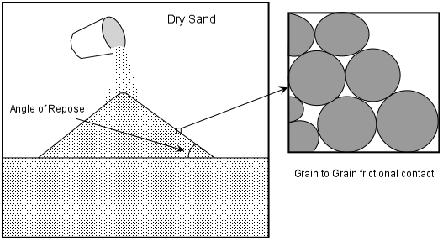
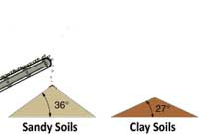
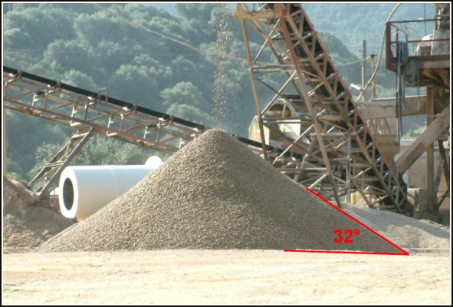
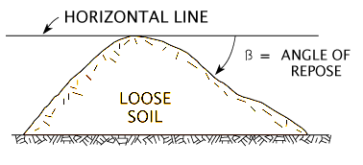
Angle of Repose (α) : limiting angle up to which the grains repose (sleep) is called the angle of repose of that granular material.
Notes:
Angle of repose:
When granular material is heaped, there exists a limit for the inclination of the surface. Beyond that angle, the grains start rolling down. This limiting angle up to which the grains repose (sleep) is called the angle of repose of the granular material.
Significance of Angle of repose:
The angle that an inclined plane makes with the horizontal, when the body supported on the plane is on the verge of motion due to its self -weight is equal to the angle of repose.
Angle of repose is numerically equal to Angle of limiting friction.

Slide 79
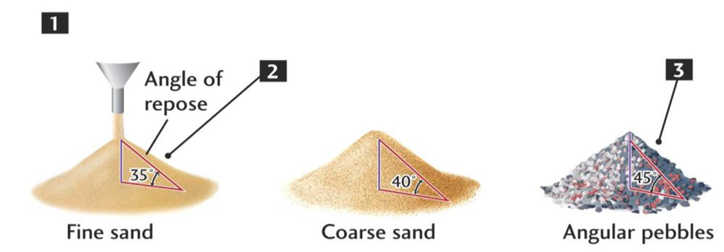
Significance of Angle of repose:
The angle that an inclined plane makes with the horizontal, when the body supported on the plane is on the verge of motion due to its self-weight is equal to the angle of repose.
Angle of repose is numerically equal to Angle of limiting friction.

Slide 80
Significance of Angle of repose
Notes:
If Ф is the value of α when motion is impending, frictional force will be limiting friction and hence tanα=tanФ

Slide 81
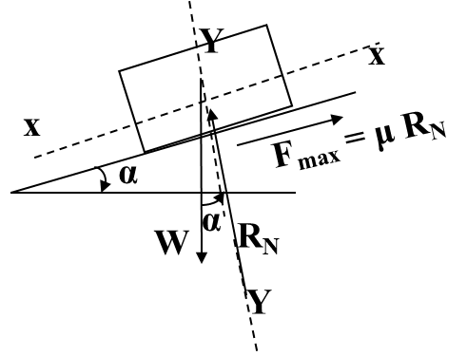
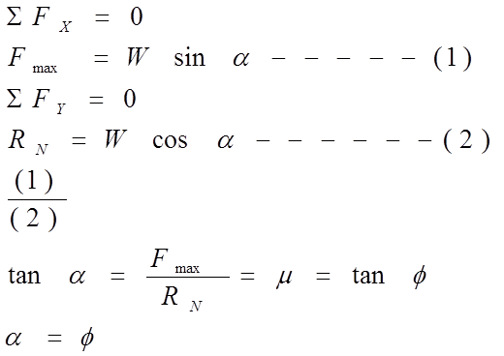
Significance of Angle of repose
Notes:
If Ф is the value of α when motion is impending, frictional force will be limiting friction and hence tanα=tanФ

Slide 82
Laws of dry Friction
The force of friction always acts in the direction opposite to the direction in which body tends to move.
The magnitude of limiting friction bears a constant ratio to the normal reaction between the two surfaces. (Experimentally proved)
After the body starts moving, the dynamic friction comes into play, the magnitude of which is less than that of limiting friction and it bears a constant ratio with normal force. This ratio is known as coefficient of dynamic friction
4. The force of friction is independent of the area of contact between the two surfaces.

Slide 83
Application Problems
Compute the magnitude of P that will cause the motion to impend up the plane. Coefficient of friction, μ = 0.20
FBD of the Block
200N
P
P
F₁ = 0.20N₁
30⁰
30°
30°
φ
R
R_{N}
200N

Slide 84
Application Problems
Method-1 (Force Triangle
tanφ = 0.2
φ = 11.3⁰
41.3°
R
200
200/Sin48.7⁰ = P/ Sin41.3°
∴ P = 175.7N
P
F₁ = 0.20N₁
90⁰
30⁰
48.7°
P
30°
φ
R
Method-2 Lami’s Theorem
131.3⁰
R
200/Sin131.3⁰ = P/ Sin138.7°
∴ P = 175.7 N
R_{N}
200N
P
138.7⁰
90⁰
200N

Slide 85
Application Problems
Method-3 Resolution
+ve
F_{Y} = 0
R_{N} – 200 Cos30- PSin30 = 0
∴ R_{N} = 200 Cos30+PSin30
F_{X} = 0
P Cos 30– 200Sin 30 – 0.2(200 Cos30+PSin30) =0
P
F₁ = 0.20R_{N}
+ve
30⁰
30°
φ
R
∴ P = 175.7 N
R_{N}
200N

Slide 86
LECTURE 9

Slide 87
Application Problems

Slide 88
Application Problems
Determine the force P required to start the 400 N wedge to the right. Take Φ=20˚ for all contact surfaces.
2000 N
P
400 N
70˚
Home

Slide 89
Application Problems
Determine the force P required to start the 400 N wedge to the right. Take Φ=20˚ for all contact surfaces.
2000 N
P
400 N
70˚
Home

Slide 90
Application Problems
Determine the force P required to start the 400 N wedge to the right. Take Φ=20˚ for all contact surfaces.
2000 N
P
400 N
70˚
Home

Slide 91
Determine the force P required to start the 400 N wedge to the right. Take Φ=20˚ for all contact surfaces.
FBD of the Block
F₁
2000 N
R₁
2000 N
F₂
P
20⁰
R₂
R_{N1}
400 N
20⁰
70˚
20⁰
R_{N2}

Slide 92
FBD of the Block
2000 N
F₁
R₂/Sin90 = 2000/Sin 50
R₂
F₂
R₁
2000 N
R₂ = 2610.8N
40⁰
20⁰
50⁰
R₂
R_{N1}
R₁
20⁰
20⁰
R_{N2}
40⁰
R₂ = 2610.8N
∑F_{y} = 0
R₃ Cos 20-400- 2610.8os 40 = 0
R₃ = 2554.01N
∑F_{x} = 0
P – 2610.8Sin 40-2554.01 Sin 20= 0
P = 2551.7N
P
400 N
F₃
R_{N3}
R₃
20⁰

Slide 93
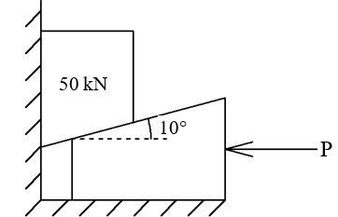
11. Find the value of the horizontal force P to raise the block of 50 kN by a 10˚wedge as shown in the figure. Take μ=0.3 for all contact surfaces.

Slide 94
F₁
50 kN
R₁
tanφ = 0.3
φ = 16.7⁰
16.7⁰
F₂
R_{N1}
R₂
16.7⁰
10⁰
26.7⁰
R_{N2}
R₂
P
F₃
R₃
R_{N3}
16.7⁰

Slide 95
26.7⁰
50kN
F₁
50 kN
R₁
90⁰
R₂
16.7⁰
16.7⁰
R₁
46.6⁰
F₂
R_{N1}
R₂
R₂/Sin106.7 = 50/Sin 46.6
16.7⁰
R₂ = 65.91kN
10⁰
R_{N2}

Slide 96
R₃
26.7⁰
43.4⁰
R₂ = 65.91kN
R₂
73.3⁰
63.3⁰
P
P
F₃
65.91/Sin73.3 = P/Sin 43.4
R₃
R_{N3}
16.7⁰
P = 47.28kN

Slide 97
A ladder of length 5m weighing 500N is placed at 45˚ against a vertical wall. The coefficient of friction between the ladder and wall is 0.2 and ladder and ground is 0.5. If a man weighing 600N ascends the ladder, how high will he be when the ladder slips.
If a boy now stands on the bottom of the rung of the ladder what must be his least weight so that the man can go up to the top of the ladder.
600 N
B
R_{B}
500N
45˚
600 N
F.B.D of the ladder
45˚
45˚
B
45˚
F_{B} = 0.2 R_{B}
2.5m
FA = 0.5 R_{A}
45˚
2.5m
X
45˚
A
45˚
45˚
A
R_{A}

Slide 98
F.B.D of the ladder
600 N
B
R_{B}
500N
45˚
45˚
45˚
45˚
F_{B} = 0.2 R_{B}
+
2.5m
ΣF_{H} = 0
0.5 R_{A} – R_{B} = 0
ΣF_{V}= 0
+
F_{A} = 0.5 R_{A}
45˚
2.5m
R_{A}+ 0.2 R_{B} -1100 =0
R_{A} +0.2x0.5R_{A} =1100
R_{A} = 1000N
R_{B} =500N
X
45˚
A
45˚
R_{A}
+
ΣM_{A} = 0
500 cos 45x5 +0.2 x500 sin 45 x 5-600 cos 45 x X – 500 cos 45 x 2.5 = 0
X = 2.92m along the ladder from A or 2.06m above A

Slide 99
F.B.D of the ladder
600 N
45˚
B
R_{B}
+
500N
ΣF_{H} = 0
0.5 R_{A} – R_{B} = 0
ΣF_{V}= 0
45˚
45˚
45˚
F_{B} = 0.2 R_{B}
+
W
2.5m
R_{A}+ 0.2 R_{B} -1100 -W =0
R_{A} +0.2x0.5R_{A} – W =1100
FA = 0.5 R_{A}
2.5m
45˚
45˚
A
45˚
R_{A}
+
ΣM_{A} = 0
R_{B} cos 45x5 +0.2 x R_{B} sin 45 x 5-600 cos 45 x 5 – 500 cos 45 x 2.5 = 0
R_{B} =708.3N
R_{A} =1416.67N
W = 458.34N

Slide 100
A ladder 6m long is supported as shown in figure. Coefficient of friction between floor and ladder is 0.5 and between wall is 0.25 and it supports a vertical load of 1000N.
Determine the least value of θ at which the ladder may be placed without slipping.
Find the reaction at A and B.
Take weight of the ladder as 200N.
1000 N
1000 N
B
R_{B}
B
200N
ϴ
ϴ
ϴ
ϴ
F.B.D of the ladder
F_{B} = 0.25 R_{B}
3m
5m
FA = 0.5 R_{A}
ϴ
3m
θ
5m
ϴ
A
A
R_{A}

Slide 101
F.B.D of the ladder
1000 N
B
R_{B}
200N
ϴ
ϴ
ϴ
ϴ
F_{B} = 0.25 R_{B}
+
3m
ΣF_{H} = 0
0.5 R_{A} – R_{B} = 0
ΣF_{V}= 0
+
FA = 0.5 R_{A}
ϴ
3m
R_{A}+ 0.25 R_{B} -1200 =0
R_{A} +0.25x0.5R_{A} =1200
R_{A} = 1066.67N
R_{B} =533.33N
5m
ϴ
A
R_{A}
+
ΣM_{A} = 0
533.33Sin ϴ x6 +0.25 x533.33 Cosϴ x 6-1000 cos ϴ x 5 – 200 cos ϴ x 3 = 0
ϴ = 56.31⁰

Slide 102
TUTORIAL (Additional)

Slide 103
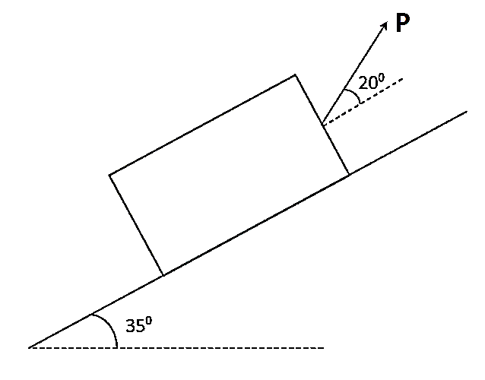
3. A block weighing 200 kN is resting on an inclined plane and is acted upon by force P as shown in the figure. If the coefficient of friction between the inclined plane and block is 0.3, calculate force P required to impend the block up the plane. (3 marks)

Slide 104
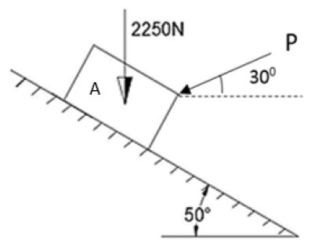
4. Block A shown in figure is in contact with 50° inclined plane. The coefficient of friction between plane and block is 0.25. Compute the value of force 'P' necessary to just prevent the motion of the block down the plane. (2 marks)

Slide 105
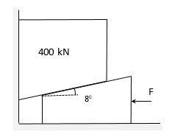
5. A block of weight 400 kN is lifted by a wedge as shown in the figure. Calculate force ‘F’ required to rise the block. Consider angle of limiting friction as 19° at all contact surfaces. (4 marks)

Slide 106
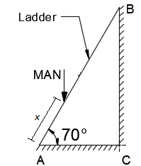
6. A man weighing 750 N starts to climb 7m long ladder weighing 250 N. Determine distance ‘x’ indicated in the figure when the ladder starts to slip. The coefficient of friction for all rubbing faces is 0.30. (3 marks)

